Slide 1
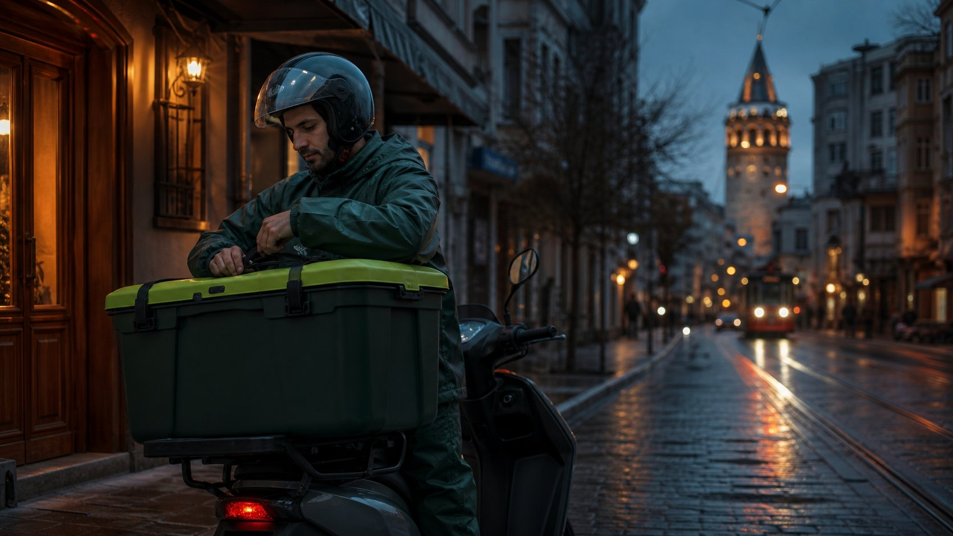
atikova.
INVESTOR PRESENTATION · OCTOBER 2026
Kitchen waste, collected by the couriers already on the road.
Istanbul pilot · COP31, Antalya, 9–20 November 2026
Atikova · Investor presentation · October 2026 · Not an offer of securities
AI illustration
Notes:
This is Atikova. We collect restaurant kitchen waste using the motorcycle couriers who are already on the road in Istanbul.

Slide 2
THE PROBLEM
Türkiye still buries most of its waste — and half of it is organic.
34.4 Mt
municipal waste generated in 2024
Source: TÜİK / Ministry of Environment, 2025
81%
of municipal waste sent to landfill (2021)
Source: EEA, 2025
~50%
of municipal waste is organic
Source: EEA, 2025
8
biological treatment plants for 85 million people
Source: EEA, 2025
Atikova · Investor presentation · October 2026 · Not an offer of securities
atikova. 2/15
Notes:
Türkiye generated thirty-four million tonnes of municipal waste in 2024. About eighty-one percent still goes to landfill, around half of it is organic, and the whole country has only eight biological treatment plants.

Slide 3
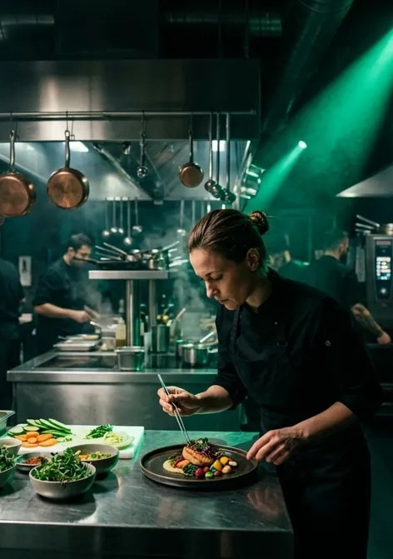
WHY IT MATTERS
Buried food becomes methane. Cutting waste pays.
≈80×
Methane's warming power compared with CO₂ over 20 years
Source: IPCC AR6, 2021
7 : 1
Return on investment in food-waste reduction in hotels; 95% of sites saw a positive return
Source: Champions 12.3 (WRI & WRAP), 2018
−21%
Food waste cut in the first year at the hotels studied
Source: Champions 12.3 (WRI & WRAP), 2018
atikova. 3/15
Atikova · Investor presentation · October 2026 · Not an offer of securities
AI illustration
Notes:
Buried food waste produces methane, a gas about eighty times stronger than carbon dioxide over twenty years. And cutting waste pays: in a study of hotels, every dollar invested returned about seven.

Slide 4
OUR SOLUTION
A sealed box, a courier with spare capacity, a weighed pickup.
80 L
Sealed kitchen-waste box per restaurant, about 32 kg
Atikova design assumption
150 L
What one motorcycle carries per trip, about 40 kg
Atikova design assumption
0
Leftover food for people — only separated kitchen waste
atikova. 4/15
Atikova · Investor presentation · October 2026 · Not an offer of securities
AI illustration
Notes:
Our solution is simple. A restaurant separates its kitchen waste into a sealed eighty-litre box. A courier with spare capacity in quiet hours picks it up, weighs it, and delivers it to compost or biogas.

Slide 5
HOW IT WORKS
Four steps, every kilo on record.
1
2
3
4
Request
The restaurant books a pickup in the app or by message.
Match
The nearest courier with spare capacity gets the job.
Collect
Motorcycle or van, depending on the volume.
Weigh & report
Weight and origin recorded; a monthly report for each restaurant.
Atikova · Investor presentation · October 2026 · Not an offer of securities
atikova. 5/15
Notes:
Matching is based on location, every pickup is weighed, and each restaurant gets a monthly report of the waste it kept out of landfill.

Slide 6
WHERE WE STAND — HONESTLY
What exists today, and what is not proven yet.
Built
✓ Website in 4 languages with a 100-source research base
✓ AI assistant on the web and Telegram
✓ Collection dispatch board (running on demo data)
✓ Calculators for savings and waste-to-energy
✓ 11 reviewed courier companies as candidate partners
Not yet
✗ No paying customer
✗ No signed partner — candidates only
✗ Company not yet registered (A.Ş. planned in Istanbul)
✗ Dispatch figures are demo data
Atikova · Investor presentation · October 2026 · Not an offer of securities
atikova. 6/15
Notes:
Today we have a website in four languages, a research base of one hundred sources, an AI assistant, and a dispatch board running on demo data. We do not have a paying customer yet, and we say so.

Slide 7
BUSINESS MODEL
Three revenue lines, priced during the pilot.
Collection fee
A monthly fee per restaurant, by volume and frequency.
Sponsorship
Companies sponsor collection in a district — invoiced, B2B.
Clean feedstock
Weighed, traceable organic material for compost and biogas plants.
Prices are not set yet; the pilot will measure cost per kilo and willingness to pay.
Atikova · Investor presentation · October 2026 · Not an offer of securities
atikova. 7/15
Notes:
Revenue will come from monthly collection fees, from companies that sponsor collection in their district, and from clean organic material for compost and biogas plants.

Slide 8
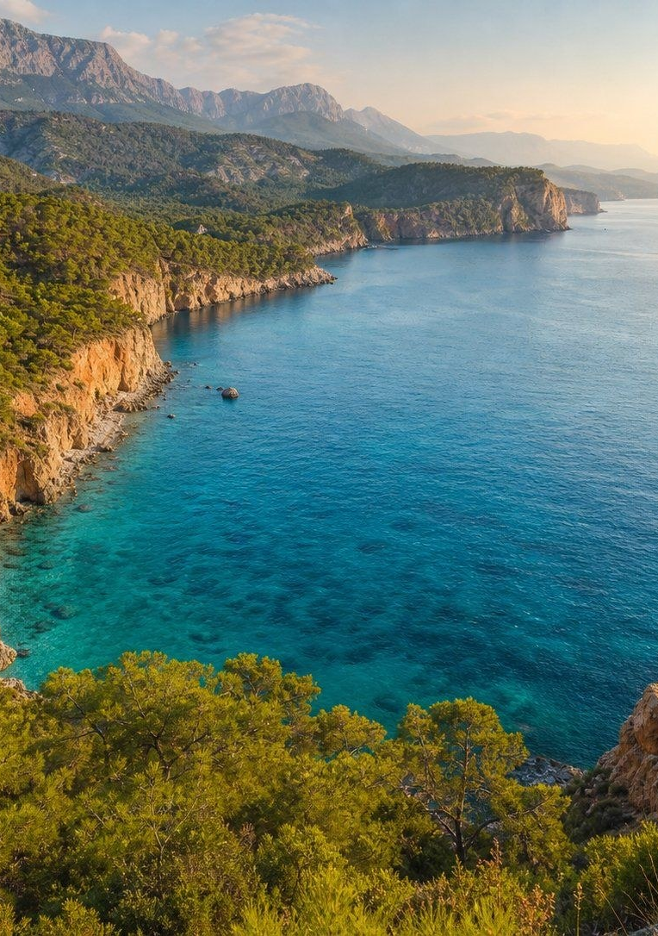
WHY NOW
COP31 comes to Antalya. The recycling target is 60% by 2035.
9–20 Nov
COP31 in Antalya, 2026 — waste and methane on the agenda
Source: cop31.tr
36%
Municipal recycling in 2024, up from 13% in 2017
Source: EEA, 2025
60%
Official recycling target for 2035
Source: EEA, 2025
atikova. 8/15
Atikova · Investor presentation · October 2026 · Not an offer of securities
AI illustration
Notes:
The timing is right. COP31 comes to Antalya in November 2026, and Türkiye's Zero Waste target is sixty percent recycling by 2035.

Slide 9
ISTANBUL, AS A SAMPLE
Half of Istanbul's household waste is organic — almost none of it is collected separately.
18,000 t
household waste a day
Source: İSTAÇ (İBB), 2026
48%
organic share (İBB waste characterisation)
Source: İBB waste characterisation, 2025
~45 t
a day of separately collected organic waste composted (Jan–Sep 2023)
Source: İSTAÇ data via Hürriyet Daily News, 2023
26%
of the city's waste recovered in 2024
Source: İBB Climate Monitoring Report 2024
Atikova · Investor presentation · October 2026 · Not an offer of securities
atikova. 9/15

Slide 10
EVERY CITY IS DIFFERENT
Every city has a different waste structure — so each needs its own policy mix.
1.46 kg
per person per day — İzmir (2020)
Source: TÜİK via Efe (2022); 2022 figures
1.43 kg
Antalya (2020) — tourism adds hotel kitchens
Source: TÜİK via Efe (2022); 2022 figures
1.13 kg
İstanbul (2022)
Source: TÜİK via Efe (2022); 2022 figures
0.66 kg
Şanlıurfa (2022)
Source: TÜİK via Efe (2022); 2022 figures
Atikova · Investor presentation · October 2026 · Not an offer of securities
atikova. 10/15

Slide 11
HOW THIS WAS MADE
Built with AI agents — every figure linked to a public source.
1
2
3
4
Read
Agents read official İBB/İSTAÇ/TÜİK data, news and research papers.
Model
They build each city's figures; estimates are labelled as estimates.
Write
Working paper, this deck and the narration — in English, Turkish and Persian.
Update
Sources and figures go to an open Hugging Face dataset, refreshed as news appears.
Atikova · Investor presentation · October 2026 · Not an offer of securities
atikova. 11/15

Slide 12
PLAN — DATES ARE TARGETS
Measure first, then grow.
Q4 2026
Register the company (A.Ş.); meetings around COP31
Q1 2027
Istanbul pilot with 10–20 restaurants (target)
Q2 2027
Pilot data → share-based crowdfunding on an SPK-listed platform
2028
Second city, if the pilot numbers hold
Atikova · Investor presentation · October 2026 · Not an offer of securities
atikova. 12/15
Notes:
Next: register the company, run a pilot with restaurants in Istanbul, and measure everything before we grow.

Slide 13
FUNDING
A staged plan — crowdfunding is one step, not the whole.
Now
Grants, invoiced sponsors, founders' capital
After the pilot
Share-based crowdfunding on an SPK-listed platform — legal cap 142.5M TL per 12 months (≈ US$2.9M at 49.5 TL/$, 17 Oct 2026)
Growth
Venture capital, then climate and development finance for processing capacity
Source: SPK Bulletin 2025/68
Use of funds will be set after the pilot. This presentation is not an offer to sell or a solicitation to buy securities; any offer will be made only on an SPK-listed platform after its investment committee approves the information form.
Atikova · Investor presentation · October 2026 · Not an offer of securities
atikova. 13/15

Slide 14
TEAM & CONTACT
atikova.
Kitchen waste, turned into a resource.
Soheil — Founder
Building the team: Istanbul operations, partnerships, engineering
info@atikova.com · atikova.com
atikova. 14/15
Atikova · Investor presentation · October 2026 · Not an offer of securities
AI illustration
Notes:
Atikova. Kitchen waste, turned into a resource. Learn more at atikova dot com.

Slide 15
SOURCES
Where the numbers come from
1. TÜİK / Ministry of Environment — Waste Monitoring Platform (2025)
https://ghg-turkiye.com/en/waste-platform
2. European Environment Agency — Türkiye municipal waste country profile (2025)
https://www.eea.europa.eu/en/topics/in-depth/waste-and-recycling/municipal-and-packaging-waste-management-country-profiles-2025/tr-municipal-waste-factsheet.pdf/@@download/file
3. European Environment Agency — Europe's environment 2025, Türkiye
https://www.eea.europa.eu/en/europe-environment-2025/countries/turkiye/waste-generation
4. IPCC AR6 WG1, Chapter 7 (2021) — methane GWP-20
https://www.ipcc.ch/report/ar6/wg1/chapter/chapter-7/
5. Champions 12.3 / WRI & WRAP — The business case for reducing food loss and waste: hotels (2018)
https://champions123.org/sites/default/files/2020-08/business-case-reducing-food-loss-and-waste-hotels.pdf
6. SPK Bülteni 2025/68 (31.12.2025) — 2026 crowdfunding limits
https://spk.gov.tr/data/695546ca8f95db281807a9c3/2025-68.pdf
7. COP31 — official site
https://cop31.tr/green-zone
8. İSTAÇ (İBB) — Evsel atık lojistik yönetimi / Tesislerimiz (2026)
https://www.istac.istanbul/faaliyet-alanlarimiz/atik-yonetimi/evsel-atik-yonetimi
9. İBB Çevre Koruma ve Kontrol D.B. — Biyometanizasyon Tesisi, waste characterisation (2025)
https://cevre.ibb.istanbul/atik-yonetimi-mudurlugu-sube-mudurlugu/biyometanizasyon-tesisi/
10. Hürriyet Daily News — Istanbul witnesses slight drop in daily waste amount (İSTAÇ data, 25 Oct 2023)
https://www.hurriyetdailynews.com/istanbul-witnesses-slight-drop-in-daily-waste-amount-data-187307
11. İBB — 2024 İklim Değişikliği İzleme Raporu (2026)
https://cevre.ibb.istanbul/iklim-degisikligi-sube-mudurlugu/2024-iklim-degisikligi-izleme-raporu-yayinlandi/
12. Efe (2022), Iğdır Univ. J. Sci. 12(4):2396–2407 — TÜİK municipal waste per capita by city; İstanbul & Şanlıurfa 2022 figures
https://dergipark.org.tr/tr/download/article-file/2516984
13. Atikova design assumption: 80 L ≈ 32 kg; 150 L ≈ 40 kg · AI illustration: images
Atikova · Investor presentation · October 2026 · Not an offer of securities
atikova. 15/15

